Slide 1


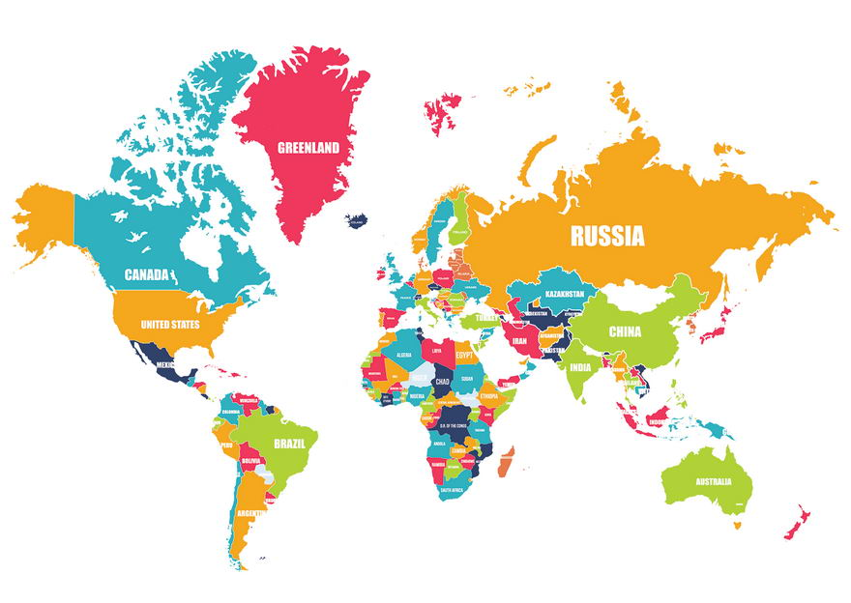


C O U N T R Y

Slide 2


UNITED STATES OF AMERICA
AMERICAN

Slide 3


PERU PERUVIAN

Slide 4

BRAZIL BRAZILIAN

Slide 5


ARGENTINA ARGENTINIAN

Slide 6


COLOMBIA COLOMBIAN

Slide 7

CHILE CHILEAN

Slide 8


MEXICO MEXICAN

Slide 9

CANADA CANADIAN

Slide 10

FRANCE FRENCH

Slide 11

SPAIN SPANISH

Slide 12

GERMANY GERMAN

Slide 13

AUSTRALIA AUSTRALIAN

Slide 14

KOREA KOREAN

Slide 15

CHINA CHINESE

Slide 16

JAPAN JAPANESE

Slide 17


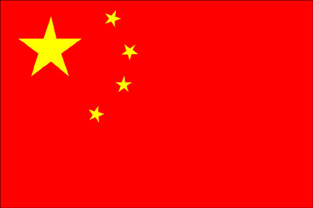










UNITED STATES
PERU
BRAZIL
ARGENTINA
SPAIN
GERMANY
JAPAN
CHINA
COLOMBIA
CHILEA
MEXICO
CANADA
FRANCE
AUSTRALIA
KOREA
15
7
8
2
13
12
14
11
6
1
10
9
5
4
3

Slide 18


ANSWER

Slide 19

JAPAN
CHINA
AUSTRALIA
PERU
KOREA
GERMANY
UNITED STATES
FRANCE
CANADA
CHILE
SPAIN
COLOMBIA
MEXICO
ARGENTINA
BRAZIL

